Slide 1
Capstone Forum
Daria Cook, Krystal Elliott, Xiaoyu Zhou

Slide 2




Slide 3

What is Mocha?
JavaScript Testing Framework on NodeJS
Features include:
Browser Support
Asynchronous Testing
Test Coverage Reports
Use of Assertion Libraries

Slide 4
describe(‘A test suite’, function() { it(‘should pass this test’, function() { assert.equal(2,1+1);
});
});
it(‘should not pass this test’, function() {
assert.equal(1,1+1);
});
});
A test suite
✓ Should pass this test
✕ Should not pass this test
1 test passing (1ms)
1 test failing (1ms)

Slide 5

Assertion Library
describe(‘A test suite’) { it(‘should pass this test’) { assert.equal(2,1+1);
}
it(‘should not pass this test’) {
assert.equal(1,1+1);
}
}
describe(‘A test suite’) { it(‘should pass this test’) { expect(1+1).to.equal(2);
}
it(‘should not pass this test’) {
expect(1+1).to.equal(1);
}
}

Slide 6



Web Development
Notes:
K

Slide 7
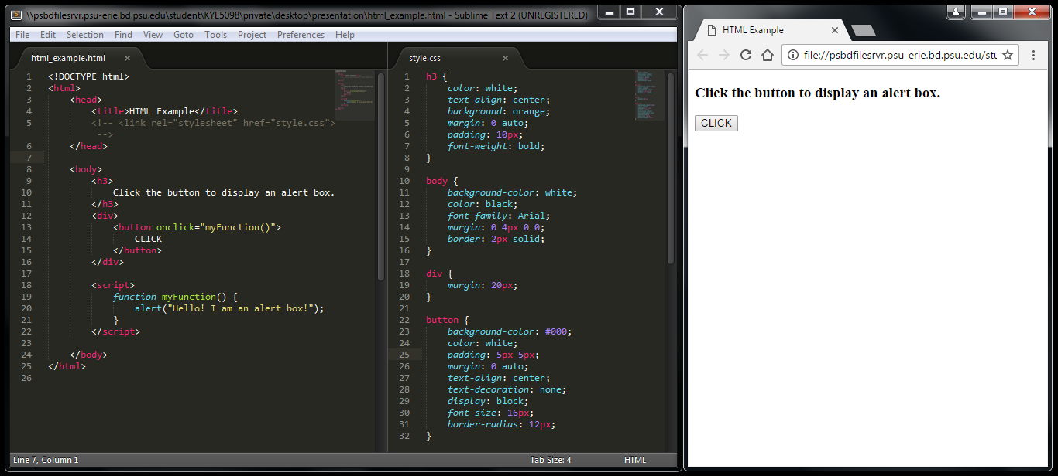
Notes:
K

Slide 8
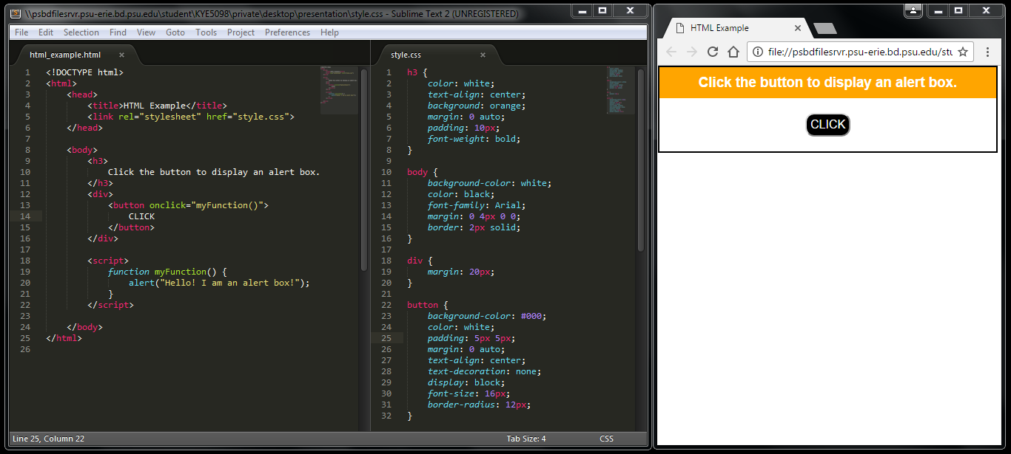
Notes:
K

Slide 9
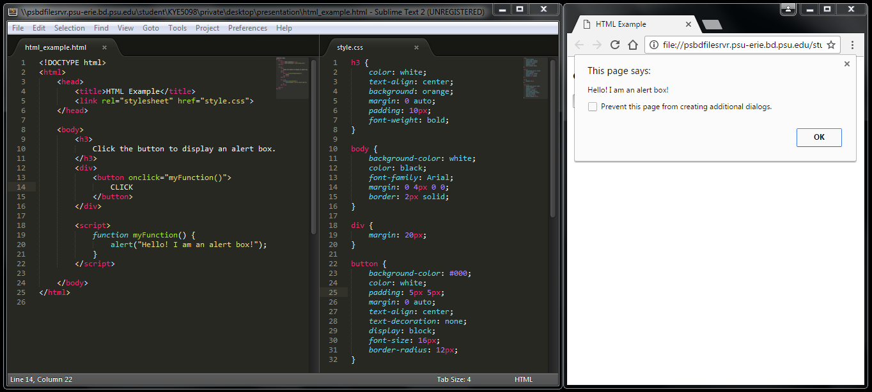
Notes:
K

Slide 10

Bootstrap
What is Bootstrap^{[1]}?
Bootstrap is an open source front-end framework. Collection of CSS classes.
Benefits of Bootstrap
Mobile-ready and responsive
Consistent design throughout all pages
Easy to use
http://stackoverflow.com/questions/14546709/what-is-bootstrap
Notes:
K

Slide 11
Natural Language Process (NLP)
AlchemyLanguage
latent Dirichlet allocation (LDA)
Natural Library
Other Mathematical and Statistical classification models

Slide 12
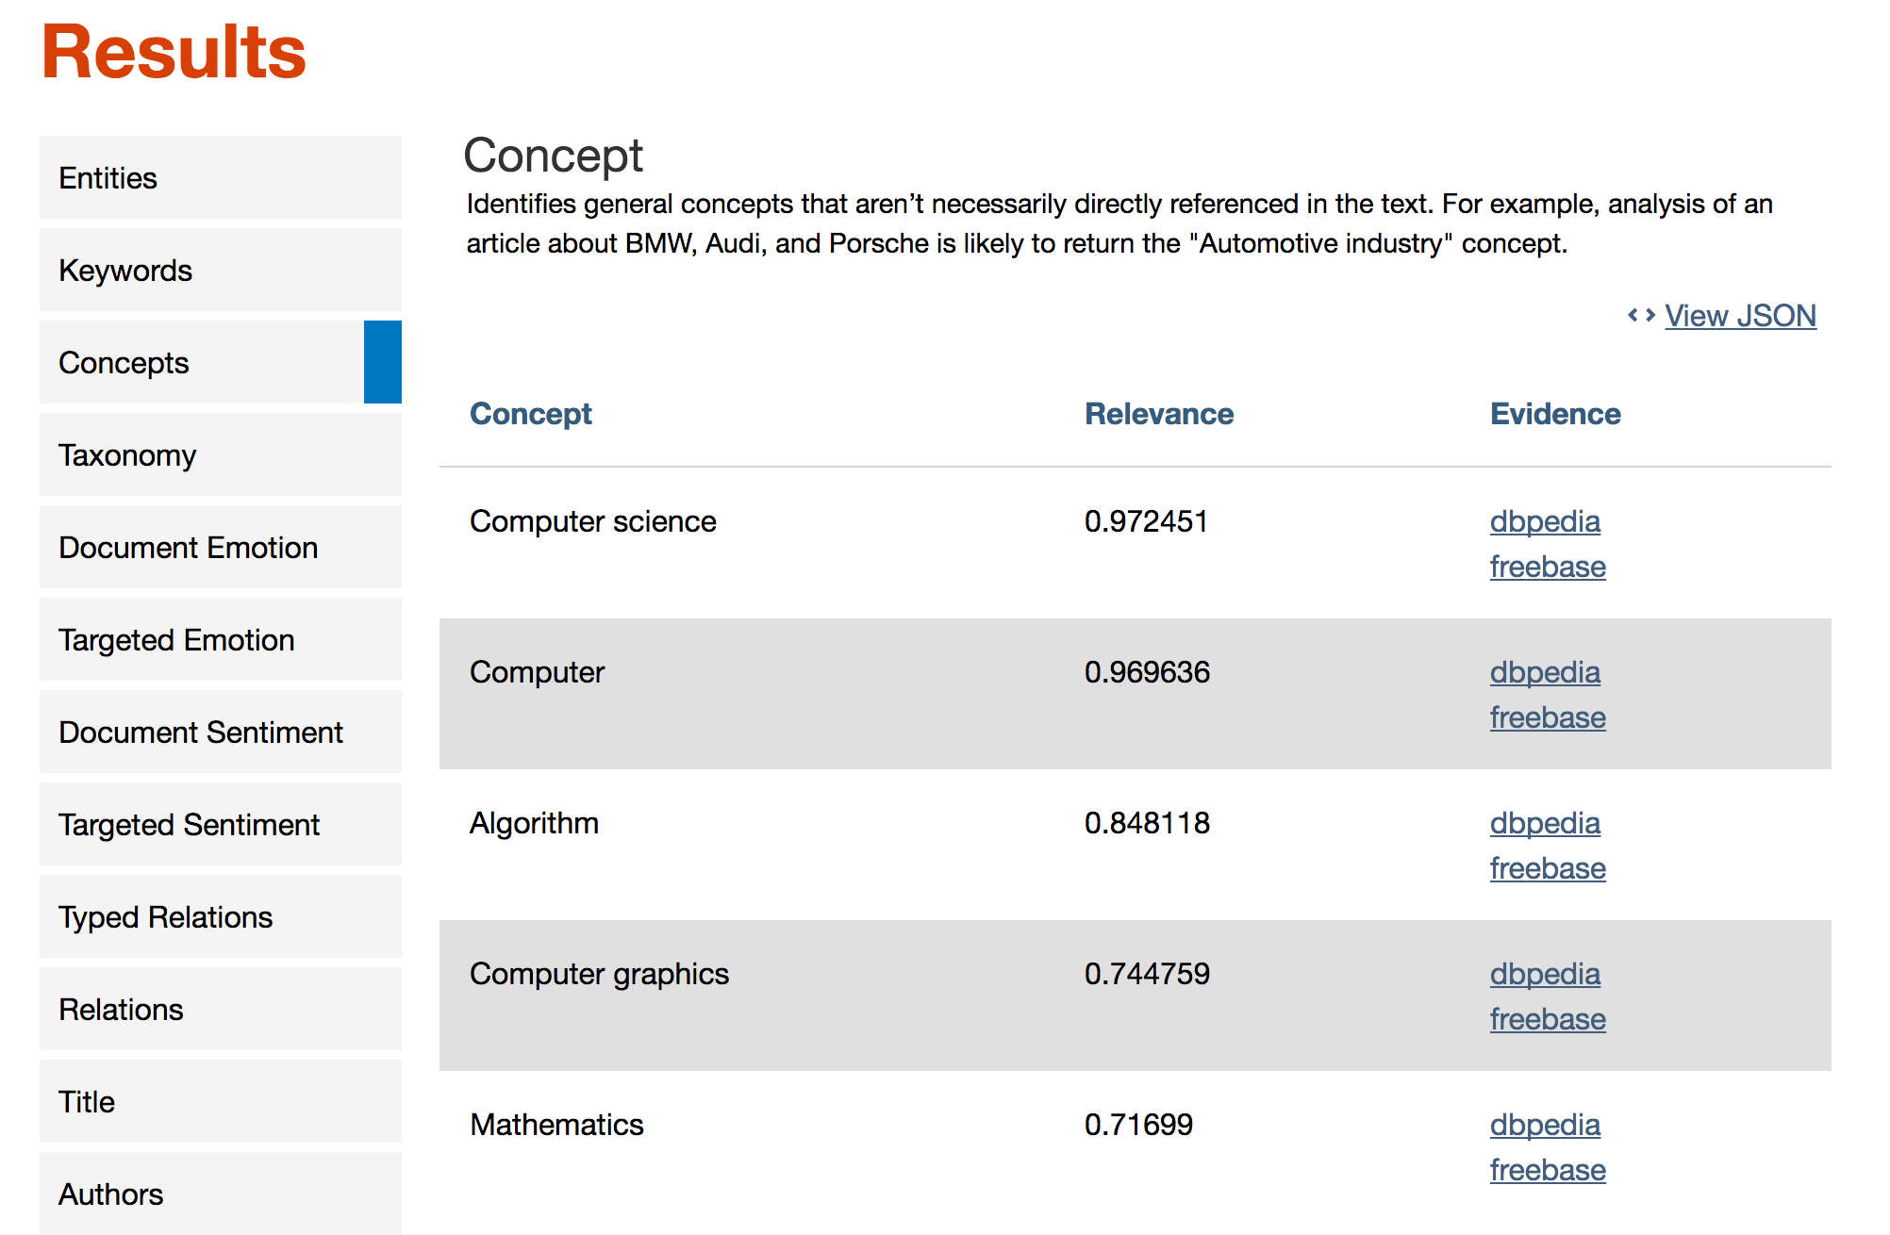
AlchemyLanguage
AlchemyLanguage is a set of APIs.
Can analyze text to help you understand its concepts, entities, keywords, sentiment, and more.

Slide 13
LDA
It’s a way of automatically discovering topics that sentences contain.
I like to eat broccoli and bananas.
I ate a banana and spinach smoothie for breakfast.
Sentences 1 and 2: 100% Topic A
Topic A: 30% broccoli, 15% bananas, 10% breakfast, … (at which point, you could interpret topic A to be about food)

Slide 14
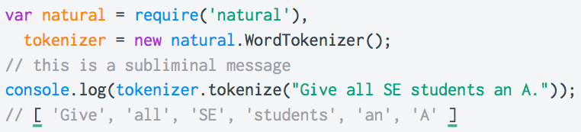

Natural Library
"Natural" is a general natural language facility for nodejs. Tokenizing, stemming, classification, phonetics, tf-idf, WordNet, string similarity, etc…

Slide 15
Fundamental classification models
Naive Baye Classification
SVM - Support vector machine
PCA - Principal component analysis
FA - Factor analysis
EM - Expectation maxminization
LLE - Local Linear Embedding

Slide 16
QUESTIONS?

